Slide 1
CH24 Wireless and Mobile Security
Notes:
This chapter provides an overview of computer security. We begin with a discussion
of what we mean by computer security. In essence, computer security deals
with computer-related assets that are subject to a variety of threats and for which
various measures are taken to protect those assets. Accordingly, the next section of
this chapter provides a brief overview of the categories of computer-related assets
that users and system managers wish to preserve and protect, and a look at the
various threats and attacks that can be made on those assets. Then, we survey the
measures that can be taken to deal with such threats and attacks. This we do from
three different viewpoints, in Sections 1.3 through 1.5. We then lay out in general
terms a computer security strategy.
The focus of this chapter, and indeed this book, is on three fundamental
questions:
1. What assets do we need to protect?
2. How are those assets threatened?
3. What can we do to counter those threats?

Slide 2
Outline
WiFi security
iOS security
Android security

Slide 3
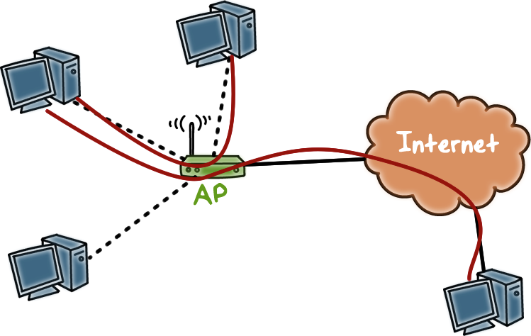
Introduction to WiFi
WiFi enables devices to access the Internet through the Access Point (AP)..
Devices in a locale can also connect to each other wirelessly through the AP.
Notes:
A typical use of WiFi is to allow personal computers, or devices enabled with WiFi, in a locale, such as a home, to access the Internet through the Access Point (or, AP). The AP connects to these devices wirelessly and connects to the Internet via physical wiring, such as to a router provided by the Internet Service Provider.
Devices in a locale can also connect to each other wirelessly through the AP.

Slide 4

Introduction to WiFi
No inherent physical protection since data is transmitted in ´the air, an open medium.
Broadcast communication between one sender and multiple receivers.
Notes:
In wireless networking, data is not transmitted via physical wires, instead, data is transmitted in air, which is an open medium. In other words, there is no inherent physical protection of communications.
Also, since there is no hard wire connecting two devices for direct communications, in wireless networking, communication between two devices is achieved by one device broadcasting and the other device listening to the broadcast.

Slide 5
WiFi Quiz
Early solution was based on Wired Equivalent Privacy (WEP)
seriously flawed
not recommended to use
New security standard for WiFi is 802.11i, implemented as WiFi Protected Access II (WPA2)

Slide 6
Overview of 802.11i
Advantages over WEP
access control model is based on 802.1X, with Extensible Authentication Protocol (EAP), a carrier protocol designed to transport the messages of different authentication protocols (e.g., TLS)
Mutual authentication process (server-to-client and client-to-server) results in a shared session key (which prevents session hijacking)
Different functions (encryption, integrity) use different keys derived from the session key using a one-way function
Different keys for encryption vs. integrity protection
Uses AES, a strong encryption method
Notes:
More advanced EAP types such as TLS provide mutual authentication, which limits man-in-the-middle threats by authenticating the server to the client, in addition to just the client to the server. Furthermore, these EAP methods result in keying material, which can be used to generate dynamic encryption keys.
802.11i also uses. It also uses AES, which is a stronger encryption method.

Slide 7

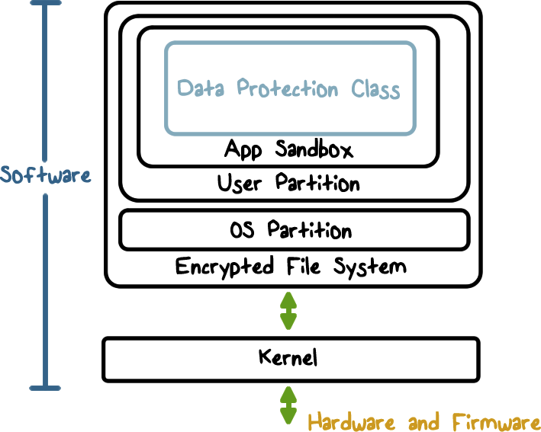
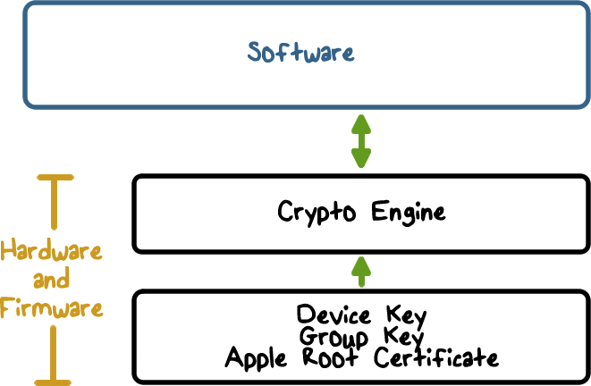
iOS Security Architecture
It combines software and hardware features to provide security.
Second, it has built-in crypto capabilities to support data protection such as confidentiality and integrity.
Third, it provides strong isolation mechanisms, e.g., app sandbox that enables apps to run securely and without compromising platform integrity.
Notes:
Here is an overview of the iOS security architecture.

Slide 8
Hardware Security Feature
Each iOS device has a dedicated AES-256 crypto engine
Manufacturer keys: Apple provides the Device ID (UID) and the device group ID (GID) as AES 256-Bit keys
UID is unique to each device
GID represents a processor class (e.g., Apple A5 processor), and is used for non security-critical tasks such as when delivering system software during installation and restore.
The UID and GID keys are burned into the chip and can only be accessed by the Crypto Engine
Notes:
iOS devices have crypto capabilities built into hardware.
Every iOS device has a dedicated AES 256 crypto engine built into the Direct Memory Access (or, DMA) path between the flash storage and main system memory, making file encryption highly efficient.
The device’s unique ID (UID) and a device group ID (GID) are AES 256-bit keys fused (UID) or compiled (GID) into the application processor and Secure Enclave during manufacturing. No software or firmware can read them directly; they can see only the results of encryption or decryption operations performed by dedicated AES engines implemented in silicon using the UID or GID as a key.
The UIDs are unique to each device and are not recorded by Apple or any of its suppliers. The GIDs are common to all processors in a class of devices (for example, all devices using the Apple A8 processor), and are used for non security-critical tasks such as when delivering system software during installation and restore.
Integrating these keys into the silicon helps prevent them from being tampered with or bypassed, or accessed outside the AES engine.

Slide 9

iOS Trusted Bootchain
The security of a device should be established when the device is turned on initially, by a chain of trust where each step ensures that the next is signed by Apple.
When an iOS device is turned on, its application processor immediately executes code from the Boot ROM. The code is immutable and serves as hardware root-of-trust. It is laid down during chip fabrication, and is implicitly trusted. It contains the Apple Root CA public key, which is used to verify that the Low-Level Bootloader (LLB) is signed by Apple before allowing it to load.
When the LLB finishes its tasks, it verifies and runs the next-stage bootloader, iBoot, which in turn verifies and runs the iOS kernel.
This secure boot chain helps ensure that the lowest levels of software are not tampered with and allows iOS to run only on validated Apple devices.
Notes:
This is the first step in the chain of trust where each step ensures that the next is signed by Apple.

Slide 10
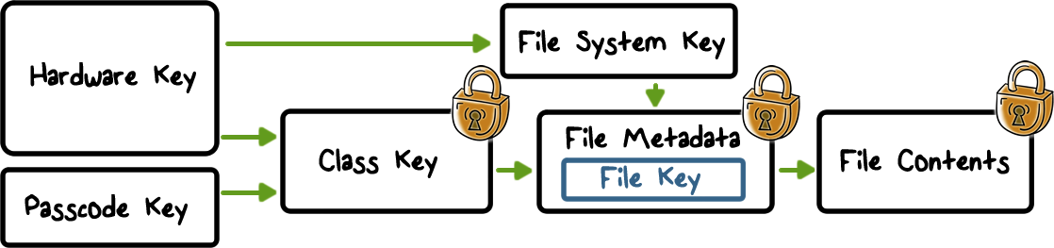
Data Protection
Data Protection protects data stored in flash memory, by constructing and managing a hierarchy of keys, and builds on the hardware encryption technologies built into each iOS device. It is controlled on a per-file basis by assigning each file to a class; accessibility is determined by whether the class keys have been unlocked.
When a file is created:
It is encrypted with a unique Per-File Key (called File Key)
The file key is encrypted with a Class Key and stored in the file’s metadata
The metadata of all files is encrypted with the File System Key, which is created when iOS is first installed or when the device is wiped by a user.
When a file is opened
Its metadata is decrypted with the file system key, revealing the encrypted per-file key and which class protects it. The file key is decrypted with the class key, then supplied to the hardware AES engine, which decrypts the file as it is read from flash memory.
The Class key is protected by the Device UID and (if configured for some files) the User Passcode
Notes:
In addition to the hardware encryption features built into iOS devices, Apple uses a technology called Data Protection to further protect data stored in flash memory on the device. Data Protection allows the device to respond to common events such as incoming phone calls, but also enables a high level of encryption for user data. Key system apps, such as Messages, Mail, Calendar, Contacts, Photos, and Health data values use Data Protection by default, and third-party apps installed on iOS 7 or later receive this protection automatically.
Data Protection is implemented by constructing and managing a hierarchy of keys, and builds on the hardware encryption technologies built into each iOS device. Data Protection is controlled on a per-file basis by assigning each file to a class; accessibility is determined by whether the class keys have been unlocked.
---
Every time a file on the data partition is created, Data Protection creates a new 256-bit key (the “per-file” key) and gives it to the hardware AES engine, which uses the key to encrypt the file as it is written to flash memory using AES CBC mode. The initialization vector (IV) is calculated with the block offset into the file and encrypted with the SHA-1 hash of the per-file key.
The per-file key is wrapped with one of several class keys, depending on the circumstances under which the file should be accessible. The wrapped per-file key is stored in the file’s metadata.
---
When a file is opened, its metadata is decrypted with the file system key, revealing the wrapped per-file key and a notation on which class protects it. The per-file key is unwrapped with the class key, then supplied to the hardware AES engine, which decrypts the file as it is read from flash memory.
The metadata of all files in the file system is encrypted with a random key, which is created when iOS is first installed or when the device is wiped by a user.
----
The content of a file is encrypted with a per-file key, which is wrapped with a class key and stored in a file’s metadata, which is in turn encrypted with the file system key. The class key is protected with the hardware UID and, for some classes, the user’s passcode.
This hierarchy provides both flexibility and performance. For example, changing a file’s class only requires rewrapping its per-file key, and a change of passcode just rewraps the class key.

Slide 11
iOS Security Quiz
Which are true?
A. All cryptographic keys are stored in flash memory
B. Trusted boot can verify the kernel before it is run
C. All files of an app are encrypted using the same key
ANS: B
A is false, since UID and GID are burned into the chip, not in flash memory
Notes:
QUIZ:
Discuss
---
SOLUTION:
1. F. 2. T. 3. F

Slide 12
Mandatory Code Signing
To ensure that all apps come from a known and approved source and have not been tampered with, iOS requires that all executable code be signed using an Apple-issued certificate.
Apps provided with the device, like Mail and Safari, are signed by Apple.
Third-party apps must also be validated and signed using an Apple-issued certificate.
Mandatory code signing extends the concept of chain of trust from the OS to apps, and prevents third-party apps from loading unsigned code resources or using self- modifying code.
Notes:
Once the iOS kernel has started, it controls which user processes and apps can be run.
All executable code has to be signed by a trusted party
Apps from App Store are signed by Apple
No dynamic code generation or self-modifying

Slide 13
Code Signing Check
At runtime, check all executable memory pages as they are loaded for code signatures to ensure that an app has not been modified since it was installed or last updated.
Enforced by kernel, handled by a user-space daemon

Slide 14
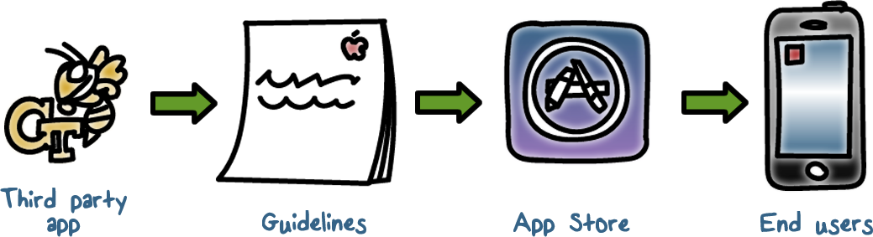
Restricted App Distribution Model
iOS devices are only allowed to download apps through the AppStore.
iOS developers must register with Apple and join the iOS Developer Program. The real-world identity of each developer, whether an individual or a business, is verified by Apple before their certificate is issued. This certificate enables developers to sign apps and submit them to the App Store for distribution. As a result, all apps in the AppStore have been submitted by an identifiable person or organization, serving as a deterrent to the creation of malicious apps. They have also been reviewed by Apple to ensure they operate as described and don’t contain obvious bugs or other problems.
Notes:
Third-party apps have to be reviewed by Apple. The apps that passed the review are signed by Apple

Slide 15
AppStore Security Quiz
In 2013 researchers were able to bypass Apple’s App store security. What method did they use?
A. Uploaded malware disguised as an app without authorization, bypassing the review and check process.
B. Uploaded an app that after it passed the review process morphed into malware.
C. Uploaded an app that led users to a site that contained malware.
ANS: B
Notes:
QUIZ:
In 2013 researchers here at Georgia Tech were able to bypass Apple’s App store security. What method did they use?
---
SOLUTION:
In the spirit of full disclosure, I was one of the researchers. A link to an article about the research can be found in the instructor’s notes.
Correct answer, an app was uploaded that morphed into malware.

Slide 16
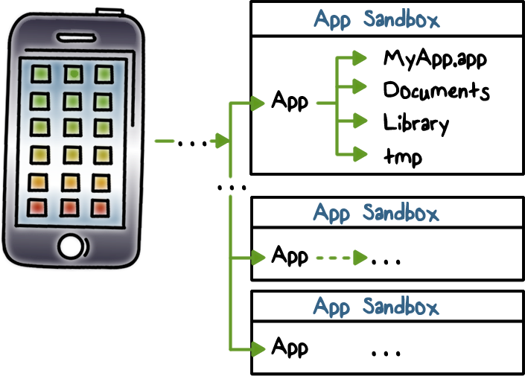
Sandboxing
All third-party apps are “sandboxed,” so they are restricted from accessing files stored by other apps or from making changes to the device. This prevents apps from gathering or modifying information stored by other apps.
Each app has a unique home directory for its files
Apps are restricted from accessing files stored by other apps or from making changes to the device
Notes:
Once an app is verified to be from an approved source, iOS enforces security measures designed to prevent it from compromising other apps or the rest of the system.
All third-party apps are “sandboxed,” so they are restricted from accessing files stored by other apps or from making changes to the device. This prevents apps from gathering or modifying information stored by other apps. Each app has a unique home directory for its files, which is randomly assigned when the app is installed. If a third-party app needs to access information other than its own, it does so only by using services explicitly provided by iOS.
----
System files and resources are also shielded from the user’s apps. The majority of iOS runs as the non-privileged user “mobile,” as do all third-party apps.
The entire OS partition is mounted as read-only. Unnecessary tools, such as remote login services, aren’t included in the system software, and APIs do not allow apps to escalate their own privileges to modify other apps or iOS itself.

Slide 17
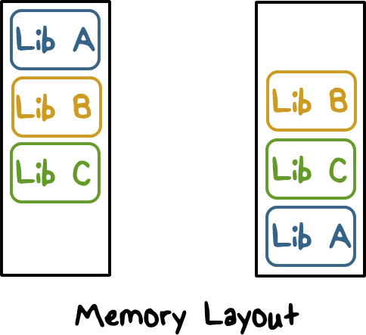
Address Space Layout Randomization (ASLR)
ASLR protects against the exploitation of memory corruption bugs. Built-in apps use ASLR to ensure that all memory regions are randomized upon launch. Randomly arranging the memory addresses of stack, heap, main executable, and dynamic libraries reduces the likelihood of many sophisticated exploits
e.g., return-to-libc attack that attempts to trick a device into executing malicious code by manipulating memory addresses of the stack and system libraries.

Slide 18
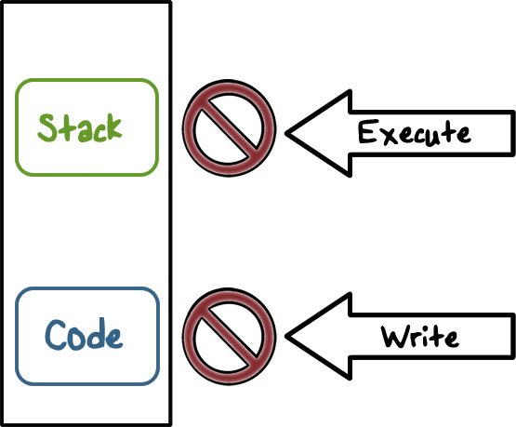
Data Execution Prevention (DEP)
DEP prevents code-injection attacks, e.g., buffer-overflow is used to write malicious code on stack or in memory and force execution to jump to the malicious code.
Data memory pages (stack, heap) are writable but non-executable,
Instruction (code) memory pages are executable but non-writable
Needs hardware support, e.g., ARM’s Execute Never (XN) feature.
Memory pages marked as both writable and executable can be used only by apps under tightly controlled conditions checked by the kernel for the presence of the Apple-only dynamic code-signing entitlement.
Notes:
Stack and Heap are not executable
W^X policy enforced on code pages
Prevents code-injection attacks
This feature prevents code-injection attacks where memory-based exploit such a buffer-overflow is used to write malicious code on stack or in memory and force execution to jump to the malicious code. W^X means that if a page is writable, meaning that new data or code can be written on the memory page, then this page is not executable.

Slide 19
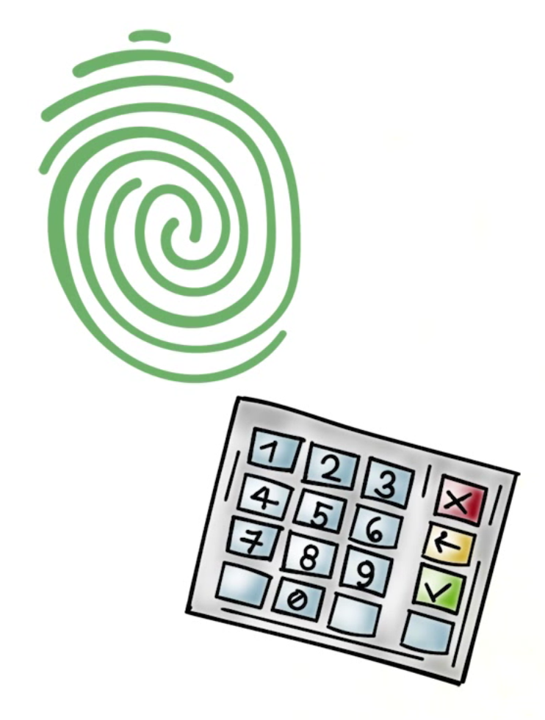
Passcodes and Touch ID
By setting up a device passcode, the user automatically enables Data Protection.
Maximum failed attempts
Progressive passcode timeout
Touch ID based on fingerprints provides convenience
Notes:
To prevent unauthorized use of a device, a user can use passcodes and touch ID.
Touch ID is the fingerprint sensing system that makes secure access to the device faster and easier.
By setting up a device passcode, the user automatically enables Data Protection.
iOS supports four-digit and arbitrary-length alphanumeric passcodes.
To further discourage brute-force passcode attacks, the iOS interface enforces escalating time delays after the entry of an invalid passcode at the Lock screen. Users can choose to have the device automatically wiped if the passcode is entered incorrectly after 10 consecutive attempts.

Slide 20
iOS Quiz
Which are true?
A. Each app runs in a sandbox and has its own home directory for its files
B. All iOS apps must be reviewed and approved by Apple
C. iOS apps can be self-signed by app developers
ANS: A, B

Slide 21
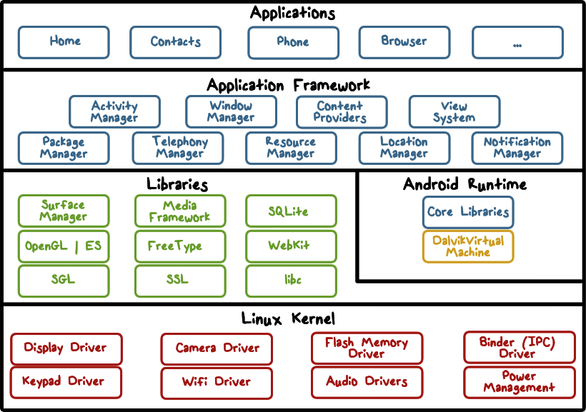
Android Security Overview
Android is implemented in the form of a software stack architecture consisting of a Linux kernel, a runtime environment and corresponding libraries, an application framework and a set of applications.
Each application running on an Android device runs its own instance of the Dalvik Virtual Machine (VM). Programs are commonly written in Java and compiled to bytecode for the Java virtual machine, which is then translated to Dalvik bytecode. The compact Dalvik Executable format is designed for systems such as smartphones that are constrained in terms of memory and processor speed.
Notes:
Here is the overview of the architecture of Android, which is based on Linux.
Applications are predominantly written in Java and run within individual instances of the Dalvik virtual machine. The key goals of the Android architecture are performance and efficiency, both in application execution and in the implementation of reuse in application design.
----
At the lowest level is the Linux kernel. It provides a level of abstraction between device hardware and the upper layer of the Android software stack.
----
----
The Android Core libraries are Java-based libraries for application development, e.g., for web browsing, data access and database queries, graphics rendering, etc.
The Android Core libraries do not actually perform much of the actual work and are, in fact, essentially Java “wrappers” around a set of C/C++ based libraries. When making calls, for example, to the android.opengl library to draw 3D graphics on the device display, the library actually ultimately makes calls to the OpenGL ES C++ library which, in turn, works with the underlying Linux kernel to perform the drawing tasks.
C/C++ libraries are included to fulfill a wide and diverse range of functions including 2D and 3D graphics drawing, Secure Sockets Layer (SSL) communication, SQLite database management, audio and video playback, bitmap and vector font rendering, display subsystem and graphic layer management and an implementation of the standard C system library (libc).
----
The Application Framework is a set of services that collectively form the environment in which Android applications run and are managed. This framework implements the concept that Android applications are constructed from reusable, interchangeable and replaceable components. This concept is taken a step further in that an application is also able to publish its capabilities along with any corresponding data so that they can be found and reused by other applications.
----
Located at the top of the Android software stack are the applications. These comprise both the native applications provided with the particular Android implementation (for example web browser and email applications) and the third party applications installed by the user after purchasing the device.

Slide 22

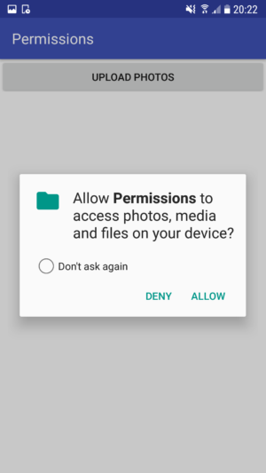
Application Sandbox
Each app runs in its own Dalvik VM as its sandbox, which provides CPU protection and memory protection
Each app is granted a set of permissions at install time, and cannot perform operations that require permissions it doesn't have.
The sandbox is based on UNIX-style user separation of processes and file permissions.
Permissions are implemented by mapping them to Linux groups with necessary read/write access to relevant system resources (files or sockets), enforced by the Linux kernel.
Notes:
Running applications in virtual machines provides a number of advantages. Firstly, applications are essentially sandboxed, in that they cannot detrimentally interfere (intentionally or otherwise) with the operating system or other applications, nor can they directly access the device hardware. Secondly, this enforced level of abstraction makes applications platform neutral in that they are never tied to any specific hardware.
Each app (UID) is granted a set of logical permissions at install time, and cannot perform operations (call APIs) that require permissions it doesn't have.
More specifically, the Android platform takes advantage of the Linux user-based protection as a means of identifying and isolating application resources. The Android system assigns a unique user ID (UID) to each Android application and runs it as that user in a separate process. The kernel enforces security between applications and the system at the process level through standard Linux facilities, such as user and group IDs that are assigned to applications. By default, applications cannot interact with each other and applications have limited access to the operating system. If application A tries to do something malicious like read application B's data or dial the phone without permission (which is a separate application), then the operating system protects against this because application A does not have the appropriate user privileges. The sandbox is simple, auditable, and based on decades-old UNIX-style user separation of processes and file permissions.
Applications announces permission requirement
Create a whitelist model – user grants access
Ask user at install time
Inter-component communication reference monitor checks permissions

Slide 23
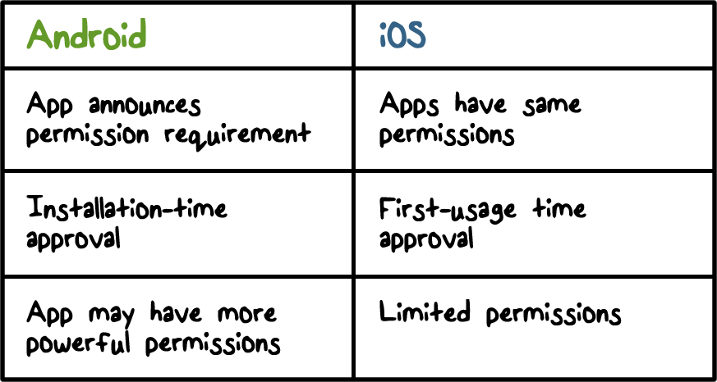

Android Sandbox vs iOS Sandbox
The main difference between Android and iOS sandboxes is how permissions are granted.
Notes:
In a comparison between Android and iOS sandbox the main difference is how permissions are granted.

Slide 24
Code Signing
All apps self-signed by developers, not by any central authority
Code signing is used for
making sure updates for an app come from the same author (same origin policy)
establishing trust relationships between apps for code/data sharing, and running in the same process
Notes:
Facilitating application upgrades

Slide 25
Android Apps Quiz
Which are true?
A. Android apps can be self-signed.
B. Android apps can have more powerful permissions than iOS apps.
ANS: A, B
Notes:
QUIZ:
Discuss
---
SOLUTION:
Answers: 1. T. 2. T.

Slide 26
Summary
Use WPA2 for WiFi security
iOS has cryptographic keys and modules built into its device hardware, uses mandatory code signing and a very restricted app distribution model, and runs app in a sandbox with run-time protection such as ASLR and DEP
Android is based on Linux and the sandbox model is based on Unix-style user separation, and its apps are self-signed

